Slide 1


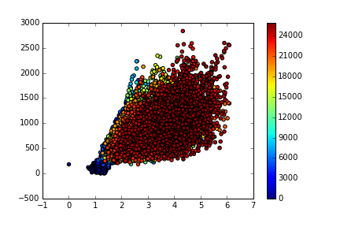
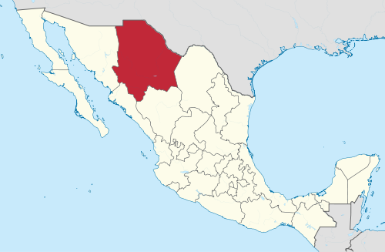

Lysiloma latisiliquum (L.) Benth: Una especie de alto potencial productivo en selvas manejadas de la Península de Yucatán, México
Ismael Pat-Aké¹*, Leider Gemalí Cobá¹, Víctor Francisco Díaz-Echeverría¹, Pablo Martínez-Zurimendi², José Francisco López-Toledo¹, Ángel May-Avila¹, Amelia Cen-Hoy¹, Addy Chavarría-Diaz¹.
¹Tecnológico Nacional de México, “Campus” Instituto Tecnológico de la Zona Maya, Km. 21.5 Carretera Chetumal-Escárcega, Ejido Juan Sarabia Quintana Roo, México.
²El Colegio de la Frontera Sur, Agricultura Sociedad y Ambiente, Unidad Villahermosa, Tabasco, México.
*Autor responsable: ismael.pa@zonamaya.tecnm.mx
Introducción
Resultados
The quick brown fox jumps over the lazy dog. The quick brown fox jumps over the lazy dog. The quick brown fox jumps over the lazy dog. The quick brown fox jumps over the lazy dog. The quick brown fox jumps over the lazy dog. The quick brown fox jumps over the lazy dog. The quick brown fox jumps over the lazy dog. The quick brown fox jumps over the lazy dog. The quick brown fox jumps over the lazy dog. The quick brown fox jumps over the lazy dog.
The quick brown fox jumps over the lazy dog. The quick brown fox jumps over the lazy dog. The quick brown fox jumps over the lazy dog. The quick brown fox jumps over the lazy dog. The quick brown fox jumps over the lazy dog. The quick brown fox jumps over the lazy dog. The quick brown fox jumps over the lazy dog. The quick brown fox jumps over the lazy dog. The quick brown fox jumps over the lazy dog. The quick brown fox jumps over the lazy dog.
Área de Estudio
Materiales y Métodos
Área de Estudio
The quick brown fox jumps over the lazy dog. The quick brown fox jumps over the lazy dog. The quick brown fox jumps over the lazy dog. The quick brown fox jumps over the lazy dog. The quick brown fox jumps over the lazy dog. The quick brown fox jumps over the lazy dog. The quick brown fox jumps over the lazy dog. The quick brown fox jumps over the lazy dog. The quick brown fox jumps over the lazy dog. The quick brown fox jumps over the lazy dog.
Figure 2. Plot dataset
The quick brown fox jumps over the lazy dog. The quick brown fox jumps over the lazy dog. The quick brown fox jumps over the lazy dog. The quick brown fox jumps over the lazy dog. The quick brown fox jumps over the lazy dog. The quick brown fox jumps over the lazy dog. The quick brown fox jumps over the lazy dog. The quick brown fox jumps over the lazy dog. The quick brown fox jumps over the lazy dog. The quick brown fox jumps over the lazy dog.
Figure 1. Study area.
Análisis Estadístico
Conclusiones
The quick brown fox jumps over the lazy dog. The quick brown fox jumps over the lazy dog. The quick brown fox jumps over the lazy dog. The quick brown fox jumps over the lazy dog. The quick brown fox jumps over the lazy dog. The quick brown fox jumps over the lazy dog. The quick brown fox jumps over the lazy dog. The quick brown fox jumps over the lazy dog. The quick brown fox jumps over the lazy dog. The quick brown fox jumps over the lazy dog.
The quick brown fox jumps over the lazy dog. The quick brown fox jumps over the lazy dog. The quick brown fox jumps over the lazy dog. The quick brown fox jumps over the lazy dog. The quick brown fox jumps over the lazy dog. The quick brown fox jumps over the lazy dog. The quick brown fox jumps over the lazy dog. The quick brown fox jumps over the lazy dog. The quick brown fox jumps over the lazy dog. The quick brown fox jumps over the lazy dog.
Referencias
Tomé M, Burkhart HE (1989) Distance-dependent competition measures for predicting growth of individual trees. Forest Science 35:816–831.
Richards F (1959) A flexible growth function for empirical use. Journal of Experimental Botany 10:290–301.
Notes:
Please export the PowerPoint document as a PDF (File – Save as – PDF) and upload the PDF into the system. Please use the font in the document or a similar one and do not use a font size smaller than 16.

